Slide 1
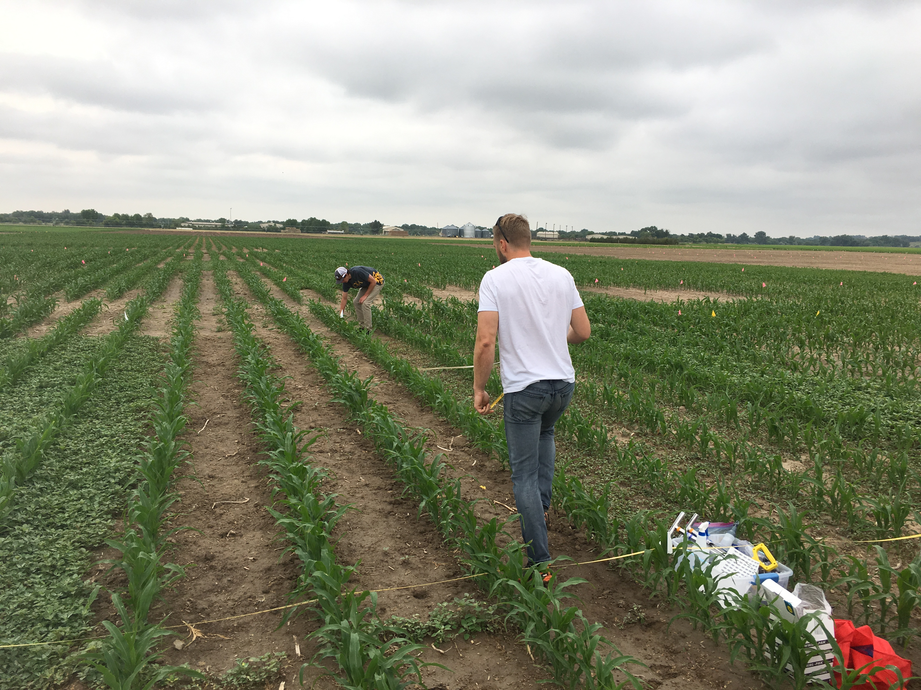
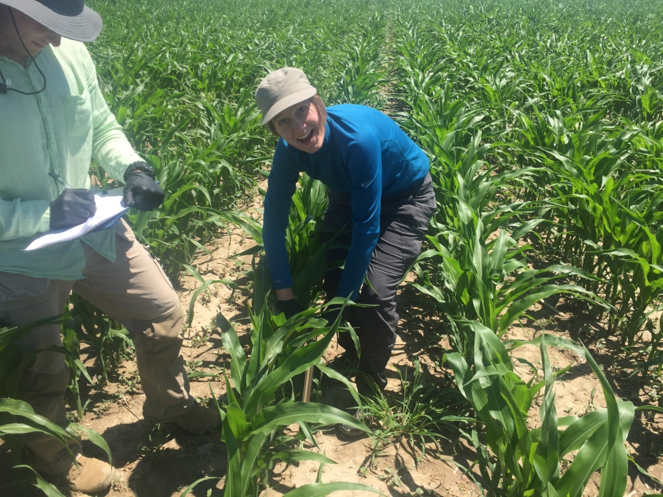
Assessing direct and indirect effects of herbicide application in an agroecosystem
Treatment | Mechanism
Clarity ® (dicamba) | Synthetic auxin
Aatrex ® & Calisto (atrazine and mesotrione tank mix) | Photosystem II & carotenoid pigment synthesis inhibitor
Roundup Powermax ® (glyphosate) | EPSPS synthase inhibitor
Handweeded | Mechanical removal
Nontreated | No weed removal
Gordon Custer, Josh Harrison, Andrew Kniss, and Linda van Diepen
Collaborators: Kniss lab and J. Harrison
Notes:
In this first study, we assess the effects of herbicide on soil properites and function.
Given that herbicide is used commonly in agro-ecosystems for control of unwanted weedy vegetation, We examined the effects of herbicide application on microbial function and nutrient pools in southeastern Wyoming.
This work was done in collaboration with the Andrew Kniss and the students in his lab. Again, a big shout out to the students and Dave Claypool for setting up these plots and applying the herbicides.

Slide 2
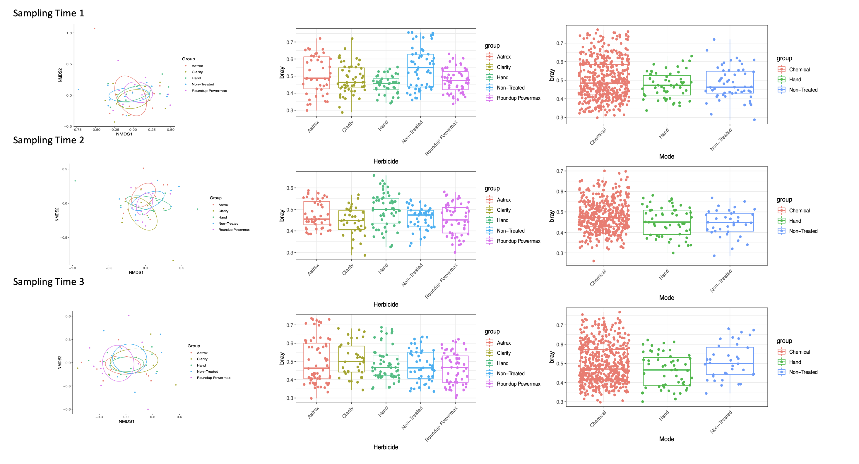
 | F.Model | R2 | Pr(>F)
Herbicide | 0.99643 | 0.02517 | 0.491508
Time | 1.52125 | 0.01921 | 0.014985
Total_Weed_Veg | 1.84544 | 0.01165 | 0.006993
Herbicide:Time | 1.18455 | 0.05984 | 0.034965

Slide 3
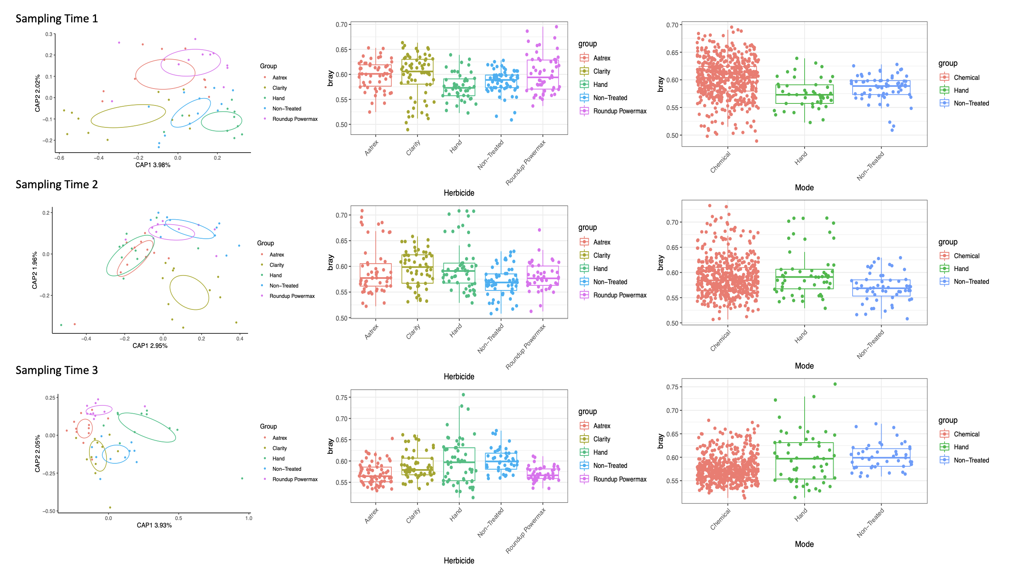
 | F.Model | R2 | Pr(>F)
Herbicide | 1.10091 | 0.02683 | 0.042957
Time | 1.09422 | 0.01334 | 0.102897
Total_Weed_Veg | 0.99821 | 0.00608 | 0.427572
Herbicide:Time | 1.18921 | 0.05797 | 0.000999

